Slide 1


Credit Card Payments:
Final Report
Ceyhun Sahinkaya
Data Science Career Track - Capstone Project #1
GitHub Project Link
Aug 2020

Slide 2
Table of Contents
Problem Statement
Data Collection
Exploratory Data Analysis
Machine Learning
Conclusion

Slide 3

Section 1:
Problem Statement

Slide 4
Project Flow
Question
How do the banks decide if a person will pay their next credit card payment?
How do the banks assess the risk of giving out loans to individuals?

Slide 5
Section 2:
Data Collection

Slide 6
DATASET OF CREDIT CARD CLIENTS IN TAIWAN FROM APRIL 2005 TO SEPTEMBER 2005
This dataset contains information on default payments, demographic factors, credit data, history of payment, and bill statements of credit card clients in Taiwan from April 2005 to September 2005.
There is no missing data on the dataset, the dataset has 3000 rows and 25 categories(columns).
The dataset is available at the below: https://www.kaggle.com/uciml/default-of-credit-card-clients-dataset
Notes:
https://visualpharm.com/

Slide 7
Section 3:
Exploratory
Data Analysis

Slide 8
Correlation
Default Payment
Marriage Status
As one variable increases or decreases, how do the other variables respond, if at all?
Education

Slide 9
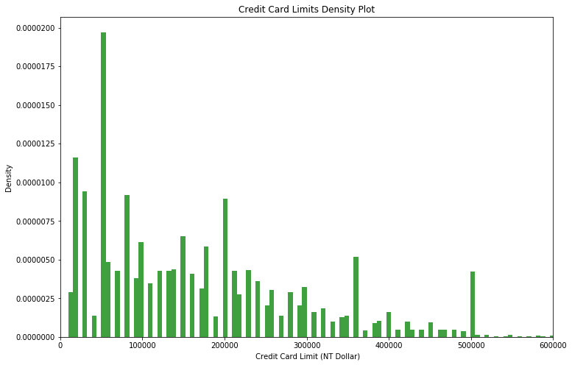
Credit Card Limit vs. Default Payment
50,000 NTD is the most frequent limit among the clients.
It has the most density, followed by 20,000 ( 1976 people), 30,000 (1610 people) and 80,000 (1567 people)

Slide 10
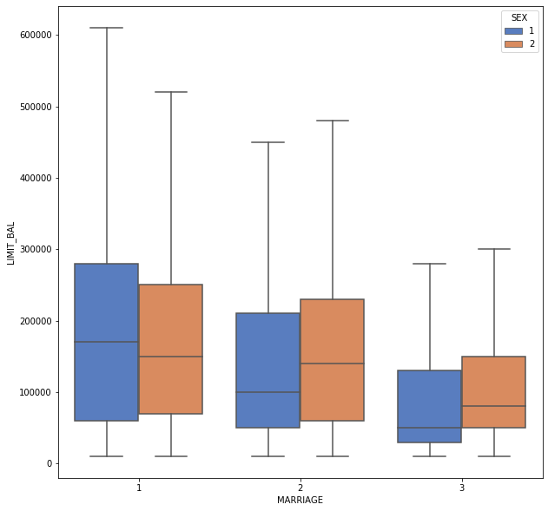
Marriage, Sex vs Credit Card Limit Balance
Male population has a bigger mean than the female population.
Married men have the bigger max credit card limit, others have the lowest credit card limit.

Slide 11
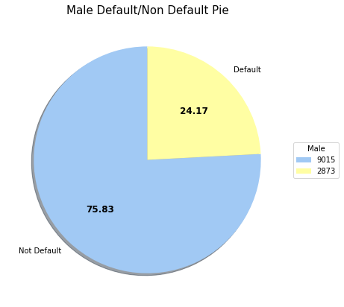
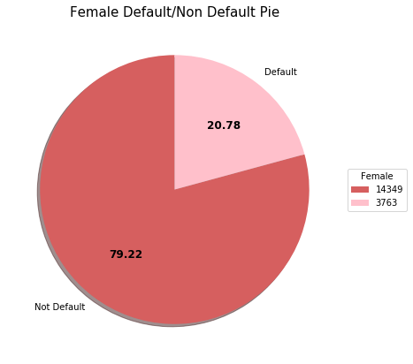
Sex vs Default Payment

Slide 12
Section 4:
Machine Learning

Slide 13
Machine Learning
XGBoost Classifier
Decision Tree
Logistic Regression
The scientific study of algorithms and statistical models to effectively perform a specific task, relying on patterns and inference, as opposed to explicit instructions.
Random Forest

Slide 14
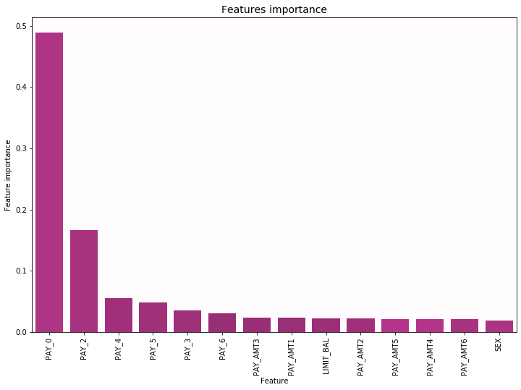
Logistic Regression
The act of fitting a line to two or more variables to show a linear relationship between them.
Most important feature for Xgboost classifier is PAY_0 (Repayment status in September, 2005 column).
Variable | Coeff
PAY_0 | 5.67
PAY_2 | 4.21
PAY_3 | 3.57
PAY_4 | 3.18
PAY_5 | 2.91
PAY_6 | 2.68

Slide 15
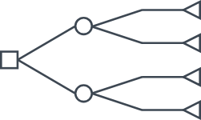
Decision Tree
GridSearch is used to test different parameters and apply the best parameters for the model
The most important feature for our model is PAY_0 (Repayment status in September, 2005 column).
Variable | Import.
PAY_0 | 0.48
PAY_2 | 0.09
PAY_AMT3 | 0.07
LIMIT_BAL | 0.06
PAY_AMT2 | 0.05

Slide 16
Random Forest
Many decision trees are used to separate the data into groups to determine their outcomes.
The best features for our Random Forest Classifier are PAY_AMT1 (Amount of previous payment in September, 2005), PAY_0 (Repayment status in September, 2005 column), LIMIT_BAL ( Amount of given credit).
Variable | Import.
PAY_AMT1 | 0.119
PAY_0 | 0.112
LIMIT_BAL | 0.111
PAY_AMT2 | 0.110
PAY_AMT3 | 0.109

Slide 17
XGBoost Classifier
Xgboost classifier is one of the most popular algorithms in the modern machine learning world due to its computing speed and performance.
The best features for our Random Forest Classifier are PAY_AMT1 (Amount of previous payment in September, 2005), PAY_0 (Repayment status in September, 2005 column), LIMIT_BAL ( Amount of given credit).
Variable | Import.
PAY_0 | 0.48
PAY_2 | 0.17
PAY_4 | 0.08
PAY_5 | 0.06
PAY_3 | 0.05

Slide 18
Machine Learning Results
Machine Learning
Metric
Classifier | Accuracy Score | AUC
Logistic Regression | 0.78 | 0.5
Decision Tree | 0.82 | 0.66
Random Forest | 0.81 | 0.65
Xgboost Classifier | 0.81 | 0.65
NOTE:
The higher the Accuracy Score, the better
The higher the AUC, the better
Notes:
Linear Regression - MPM
t2_sat_area(microns2) = 2.514793e-04
int_s_avg_5(counts/ms) = 1.243470e-04
Random Forest - MPM
Tree = 3
t2_sat_num(-) = 0.64
int_s_p(counts/ms) = 0.33

Slide 19
Section 5:
Conclusion

Slide 20
Conclusion
Most of the clients are college educated
There are 30,000 bank clients' data in this dataset.
There are more women clients than men
Results
Average credit card limit is 167,484 NT Dollar .
Data is cleaned, looked for correlation between the predictor variables and four three different models to predict if the person will default the next credit card payment or not. Based on AUC result, Decision Tree predicts best results.
Average age of the clients is 35.5 and standard deviation is 9.21.
Decision Tree Classifier gives us the best AUC score among the four models we tried in our project

